Slide 1

Overview of Connected Vehicle
Pilot Deployment Testing and Certification

Slide 2
Topics
Conformance Assessment
Benefits and Values of Certification
CV Pilot Certification Program Goals
Scope of Pilot Certification
SPaT example
Key Program Concepts
Program Process
Origin of Certification Requirements
Test Plan Scoping
Lab Engagement
Testing Phase
Certification Review/Approval
Summary of Roles/Actions of Conformance Entities
CV Certification for other Deployments & OEMs
Future Lab Accreditation Plans
Interoperability Testing – Plugfests and Test Beds
Next Steps and Upcoming Events

Slide 3
What is Certification?

Slide 4
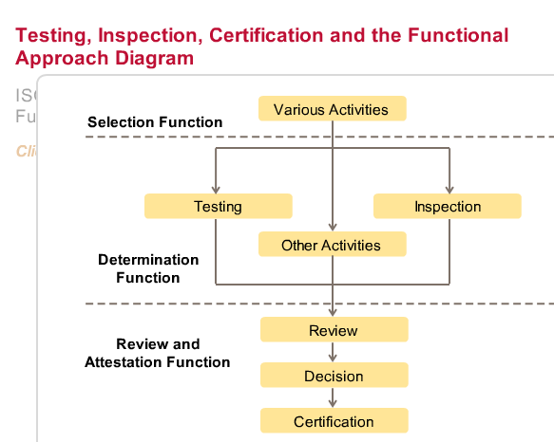
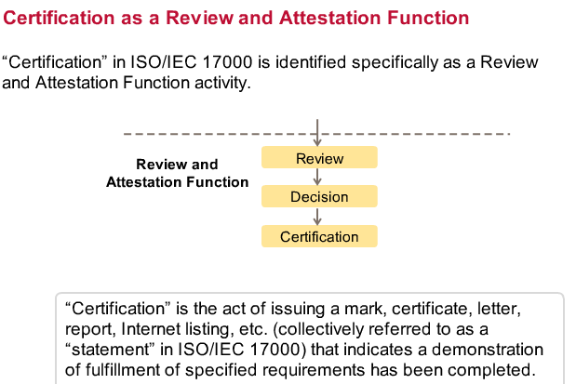

Conformity Assessment ISO/IEC 17000
Testing creates information that a specified requirement is fulfilled

Slide 5

Benefits and Value of Certification
All Stakeholders
Key driver of technology adoption
Standards based solutions in market
Reduces risk and uncertainty – Attests to demonstration of a requirement/function
  Manufacturers
  Differentiates from competition
  Expands potential customers
  Builds quality brand reputation
  Validates design and manufacturing process
  Higher customer satisfaction - fewer failures/recalls
  End Users- Deployers
  Improves procurement confidence
  Reduces cost of implementation –
    Better system integration
    Interoperability with other certified products

Slide 6
Connected Vehicle Pilot Deployment Certification

Slide 7
Goals For CV Pilot Deployment Certification
Conduct Device Testing for Conformity Assessment:
□Conformance to the message protocols
▪Ability to transmit & receive messages using specific protocols
▪Use message security and security credentials
□Conformance to performance requirements
▪Use position and timing information
▪Radio behavior characterization
□Device interoperability on select common information flows
A device must pass all requirements to obtain
COC CV Pilot Deployment Certification

Slide 8
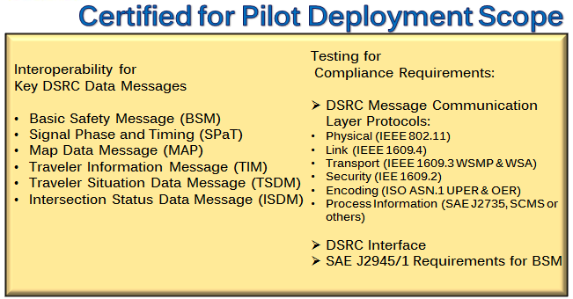
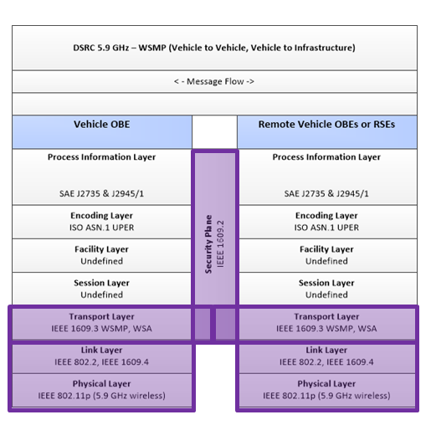
Scope of CV Pilot Deployment Certification
Examples of Modules Common to DSRC Data Messages
that require certification evaluation

Slide 9

Proposed CV Pilot Deployment Mark
The Certification Operating Council (COC) plans certification for hardware and software supporting the upcoming USDOT Connected Vehicle Pilots sites.
The Certification will be applicable toward device procurement and issuance of security credentials by the USDOT
Certified Mark awarded to evaluated device demonstrating compliance to all CV Pilot Deployment Requirements
Some conditional basis consideration may be given to devices with capabilities not meeting full certification requirements
per the discretion of U.S. DOT.

Slide 10
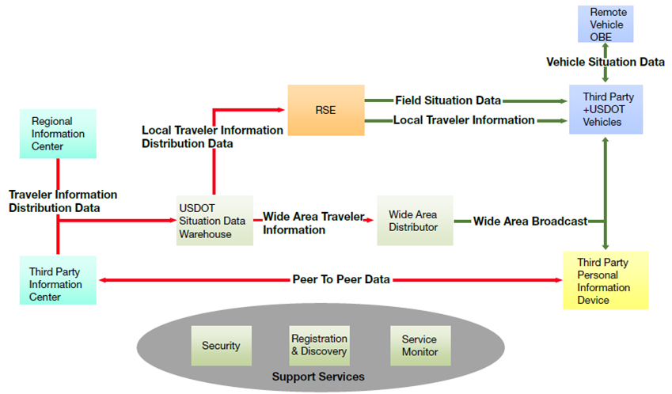
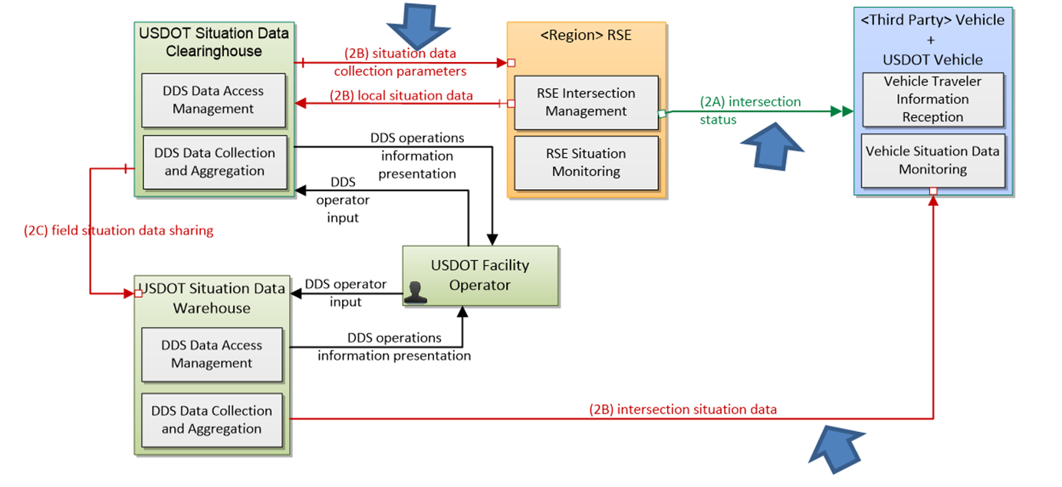
Physical Overview of Connected Vehicle Communication System
Example of a Signal Phase and Timing (SPaT) Data Flow Requirement Evaluation
2A High Priority from RSE (infrastructure) to OBE (vehicle)
2B Low Priority from Clearinghouse to RSE or a Warehouse to an OBE – future revision of CV test/certification requirements

Slide 11
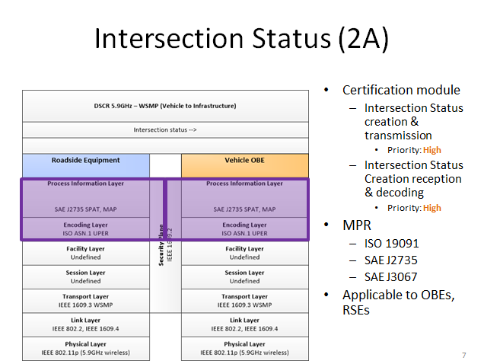
Functional Working Model of SPaT Message Exchange

Slide 12
CV Certification Program Key Concepts
Recognized Test Labs - Plans for ISO 17025 Accreditation after Pilots
Validated Test Equipment – US DOT Sponsored Testing Rounds
Common Test Procedures/Scripts
Applicant Confidentiality
Dispute Resolution Process (for non-compliant products)
Listing on Directory of Certified Devices
Guidelines for Management of Change
Guidelines for Certification Marking and Usage
Market Surveillance against false certification/compliance/conformance claims

Slide 13
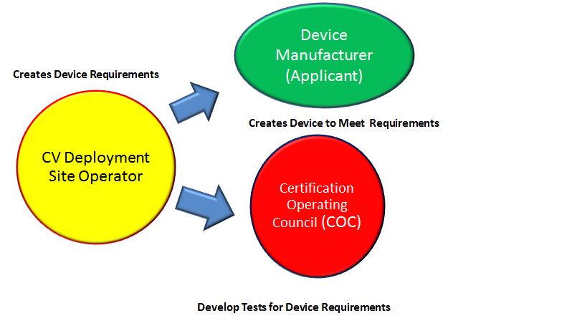
CV Pilot Deployment
Certification Process
Origin of Certification
Requirements

Slide 14
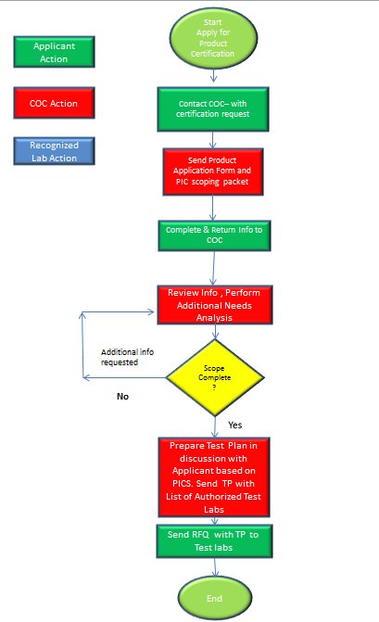
CV Pilot Deployment Certification Test Plan Scoping

Slide 15
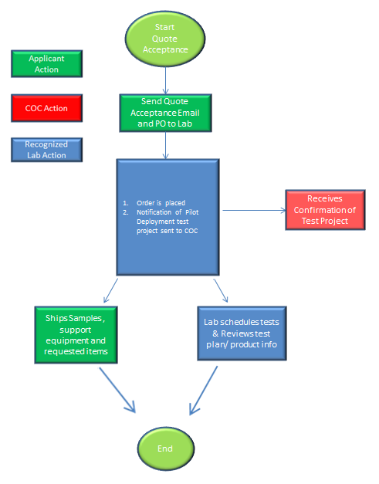
Lab Engagement for CV Certification Testing

Slide 16
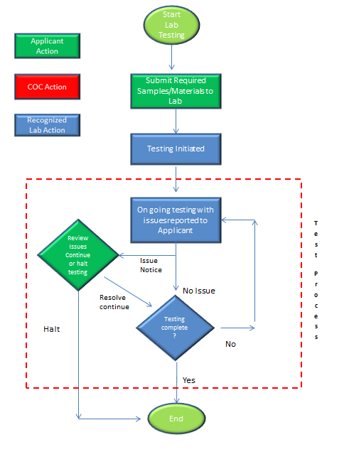
CV Certification Testing Phase

Slide 17
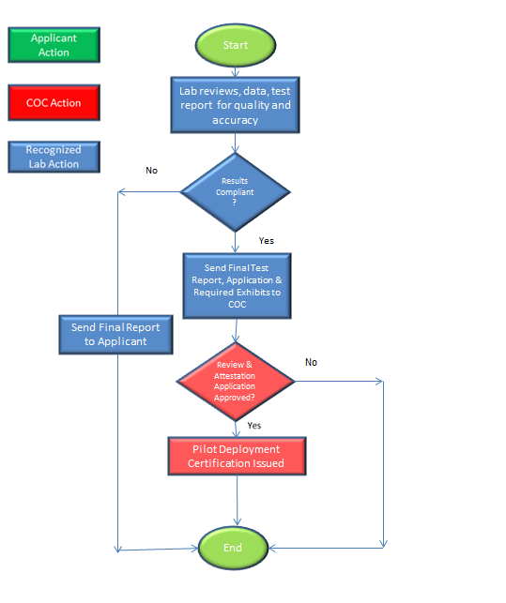
CV Certification Review/Approval Process

Slide 18
Summary of Conformity Assessment Roles & Actions
CV Deployment Site Operators
Develop Product Requirements –
What equipment features/functionality does your plan implement?
What performance do you want the equipment to exhibit?
Feedback to COC on direction of program
Participation with OmniAir to add stakeholder voice to requirements, technology advancement direction and make the process better as ITS grows.
Certification Operating Council or Future Certification Organization
Create and maintain Interoperable Feature Statement (IFS) and Protocol Implementation Conformance Statement (PICS)
Develop test methods to demonstrate requirement conformance & interoperability
Validate test tools/equipment/methods
Send Product Information Application Form and PIC Scoping Packet to Applicant
Review product features and information to determine requirement scope
Have discussion with Applicant for agreement on requirements
Prepare Product Requirement Test Plan – Send test plans and list of authorized test labs to applicant.
Receives confirmation of test project start
Review of conformance demonstration exhibits – product information, test reports, photos, test data, etc.
Make Determination of Conformance to all requirements
Issues Conformance Certification
List Product Certification on website (TBD)
Changes in device design, materials will make judgment on re-evaluating device to maintain certification or determine if new evaluation required.

Slide 19
Summary of Conformity Assessment Roles & Actions
Applicant (Device Manufacturers)
Develop devices to meet Deployment Site or other customer specification requirements
Contact the COC with CV Certification Request
Complete and return CV Certification Application and requested product information to COC
Have discussion with COC for agreement on requirements
Receive CV Certification Test Plan and List of Recognized Test Labs
Contact lab(s) of your choosing from RTL list and request a quote for testing
Send lab the product information and test plan received from COC for quoting
Review Quotes and choose lab to conduct testing – subject to individual lab business terms and conditions
After confirmation of testing schedule – ship requested samples, support equipment, documentation, etc. to lab.
Respond to lab communications of issues/failures with project direction instructions
Receive Test Reports
Receive Certification documentation and Certification Mark Usage Guidelines for demonstrated and approved conformity assessment
Recognized Test Lab
Receive and review test plan/product information from Applicant and provide quotation
Process accepted quote and schedule test program
Send sample, support equipment, documentation requests to Applicant
Conducts testing per COC test plan
Contacts Applicant with issues or failures impacting testing/certification outcome
With Applicant permission – contacts COC for dispute resolution; if necessary
Provides testing status updates as requested
Reviews test data, compiles final report, conducts internal quality and accuracy review of report
Sends Final Report to Applicant
Sends COC final report; if compliant for all requirements for Certification Review and Attestation
Provides information/addresses questions about testing conducted.

Slide 20
Open Discussion
Questions, Feedback, Recommendations

Slide 21
CV Certification – ITS Deployments and Device Manufacturers
(outside the USDOT sponsored Pilot Programs)

Slide 22
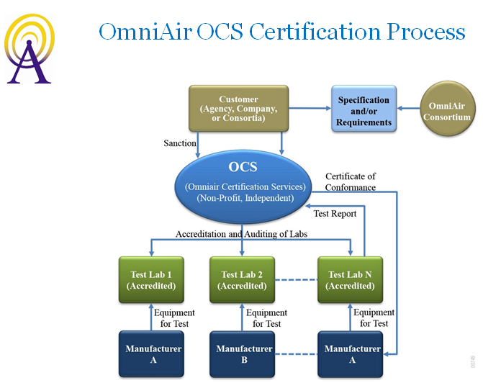

Proposed Certification Solutions for Deployment Sites
& Device Manufacturers
Mirrors USDOT CV Pilot Deployment Process
Add other requirements of interest – regulatory, safety, performance
Collaboration driven program with stakeholders for requirement stewardship
Expansion of new certification requirements

Slide 23
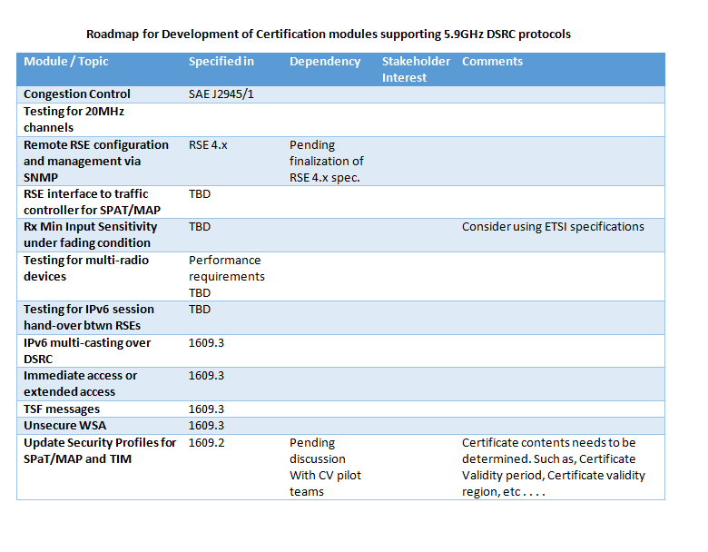
Possible Areas New Requirements – out of Pilot Scope
Deployers’ Plans for Implementation?

Slide 24
Future Laboratory Accreditation Plans

Slide 25
Future Laboratory Accreditation
What is Accreditation?
Accreditation is a process that helps one or more parties have confidence in another party's competence to carry out some conformity assessment activity.
How Does Accreditation Work?
Parties seeking accreditation must meet requirements and generally be audited to demonstrate compliance with those requirements. In Connected Vehicle DSRC testing -ISO/IEC 17025 General Requirements for the Competence of Testing and Calibration Laboratories will be required. It strongly focuses on the party’s management system.
What is the Difference Between Accreditation and Quality Management System Registration Processes?
Accreditation invokes competence requirements and specifies how certain activities must be performed while quality management system registration requirements focus on meeting customer needs.
Timeline: After Pilot Deployments
Refinement of Specific Test Methodologies for Defined Scope
Engagement with Third Party Accreditation Organizations
Lab Preparation for Scope Expansion
Audits/Competency Demonstration

Slide 26
Interoperability Testing and the Importance of Plugfests and Test Beds

Slide 27
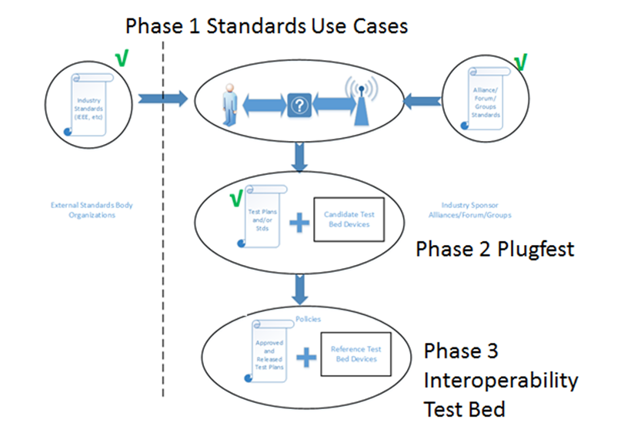
Interoperability Testing –
The Importance of PlugFests and Test Beds
According to Merriam-Webster Interoperability is the “ability of a system to work with or use the parts or equipment of another system”.
To expand the adoption of new interoperable technologies in products, standards and use cases are developed and must then be tested.
Plugfests or interoperability events are good ways to generate initial trusted test data and performance.
Plugfests require a prescribed industry supported program for interoperability verification.
It is through Plugfest events that reference devices are chosen for future test beds.

Slide 28
Steps to a Successful Interoperability Program
Phase One – Standards and Use Cases
Industry consensus on standards governing a new technology
Use Cases describe the most used scenarios for the technology
Unusual Use Cases should also be included
Requirements become test cases which make up a verification test suite
Requirements shall be tested using a mixed vendor test bed
against a Device Under Test (DUT)
Phase Two – Plugfests
Interoperability (IOP) testing = peer-2-peer testing towards test tools and testing against a verification test suite
Opportunity for device manufacturers to exercise their new implementations not yet out in the market
Ensures a device’s interpretations of the requirements are in compliance and similar to other vendor members.
Testing is performed under NDA to protect the confidentiality and intellectual property of the participants
Testing area is inaccessible to non-participants
Verifies Product Requirement
Candidates for IOP test bed reference devices are identified
Phase Three – IOP Test Beds
Choosing Reference Devices for a typical IOP test bed
Must have passing results for both mandatory and optional test cases
A device shall have participated in a minimal of 2 plugfests with passing results against a minimal of 2 devices
A vendor shall approve the candidate device to be added to the Interoperability Reference Device List
Recommendation that candidate devices have unique DSRC/wireless chip set

Slide 29
Open Discussion
Questions, Feedback, Recommendations

Slide 30
Upcoming Events / Next Steps
Device certification timeline for CV Pilots
Test specification workshop
  Expected timeline – February 2015 (date TBD)
  Aims to share test specifications and test system interface specifications
USDOT sponsored testing for CV Pilots –
  Expected timeline - May-June 2015
  Aims to validation test specifications and test tools
  Initial testing of early device submissions
Industry sponsored testing for CV Pilots –
  Expected timeline – October – November 2015
  Aims to validate device implementations
    Award certificates of compliance to devices
Certification Events
Certification workshop for CV Pilot in New York
  Expected timeline – date TBD
Certification workshop for CV Pilot in Wyoming
  Expected timeline – date TBD

Slide 31
Thank You

