Slide 1

Standards Rapid Consensus
Day 2, AM – Field Situation Data,
Data Clearinghouse
Walton Fehr, Transportation Specialist

Slide 2

Welcome
  Presenter –
  Walton Fehr
  USDOT ITS Joint Program Office
  walton.fehr@dot.gov
  www.its.dot.gov
Topics –
Field Situation Data and Data Clearinghouse deposits
  (1) the short-range broadcast data provided by roadside equipment to vehicles
  (2) deposits to the situation data clearing house used for analytics,
  (3) deliveries from the situation data warehouse used to inform vehicles of controlled intersections.
WAVE IP transport

Slide 3
Important Points
Field Situation Data Application Protocol Data Units are the same, independent of who creates them and now they are delivered to the ultimate using Application Object.
Data Units are collections of data elements defined in SAE J2735 or in the style of J2735. Time is always a data element included.
  The agreed upon version of J2735 will be used for all multi-site interoperable Data Units.
  All sites will use the same interpretation (data element choices, naming and numbering conventions, etc.)
Using the Situation Data Clearinghouse/Warehouse is encouraged.
All RSU’s will advertise IP service

Slide 4
Context Diagrams – Physical View

Slide 5
Communication View – Field to Vehicle

Slide 6
Radio Parameters
Message (Rate in Hz)
BSM (10)
IPv6
IPv6
WSA (10)
IPv6
IPv6
IPv6 Exchanges
OBE with SCMS via RSE
OBE with SDC/SDW via RSE
  VSDM
  TSDD
SPAT (10)
TIM (Var)
MAP (1)
RTCM (?)
Power Limit (EIRP)
44.8 dBm
Power Limit (EIRP)
33 dBm
Public
Safety
Veh-Veh Ch 172
Public
Safety/
Private
Ch 174
Public
Safety/
Private
Ch 176
Public
Safety/
Private
Ch 180
Public
Safety/
Private
Ch 182
Public
Safety
Intersections
Ch 184
Control Channel
Ch 178
Frequency (GHz)
5.835
5.840
5.845
5.850
5.855
5.860
5.865
5.870
5.875
5.880
5.885
5.890
5.895
5.900
5.905
5.910
5.915
5.920
5.925
ALL Channels:
  6 Mbps data rate – Per J2945/1
  10MHZ spacing – Per 802.11 Operating Class 17 (J2945/1)
  Station Transmit Power Classification C
  MAP and SPaT on Channel 172

Slide 7
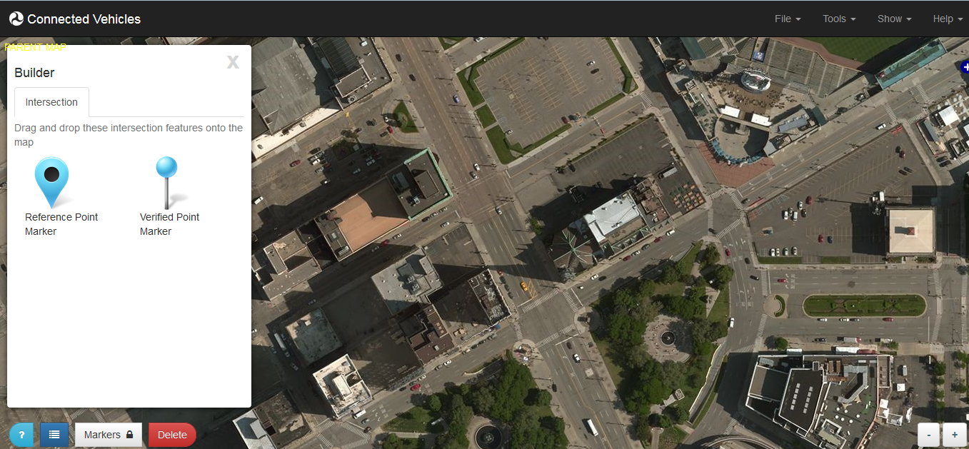
Data Unit Conventions
MAP
  Parent, Child Data Units
  Regionally-unique identifier
  All approaches, lanes, and movements accounted for
  https://ec2-54-211-216-181.compute-1.amazonaws.com/isd/;jsessionid=1qge4r8f9v9ejjrtpywneq4m2#

Slide 8
Data Unit Conventions
SPaT
  All Data Units will have at least the state of the control for each element of the MAP.

Slide 9
Performance Requirements for MAP, SPaT
TBD

Slide 10
IP Transport
All RSU’s will advertise IP transport. Sites will determine the uses of that capability.
  Will be available for SCMS interactions with vehicle equipment.
  Other uses as appropriate for backhaul capabilities and usage policies.

Slide 11
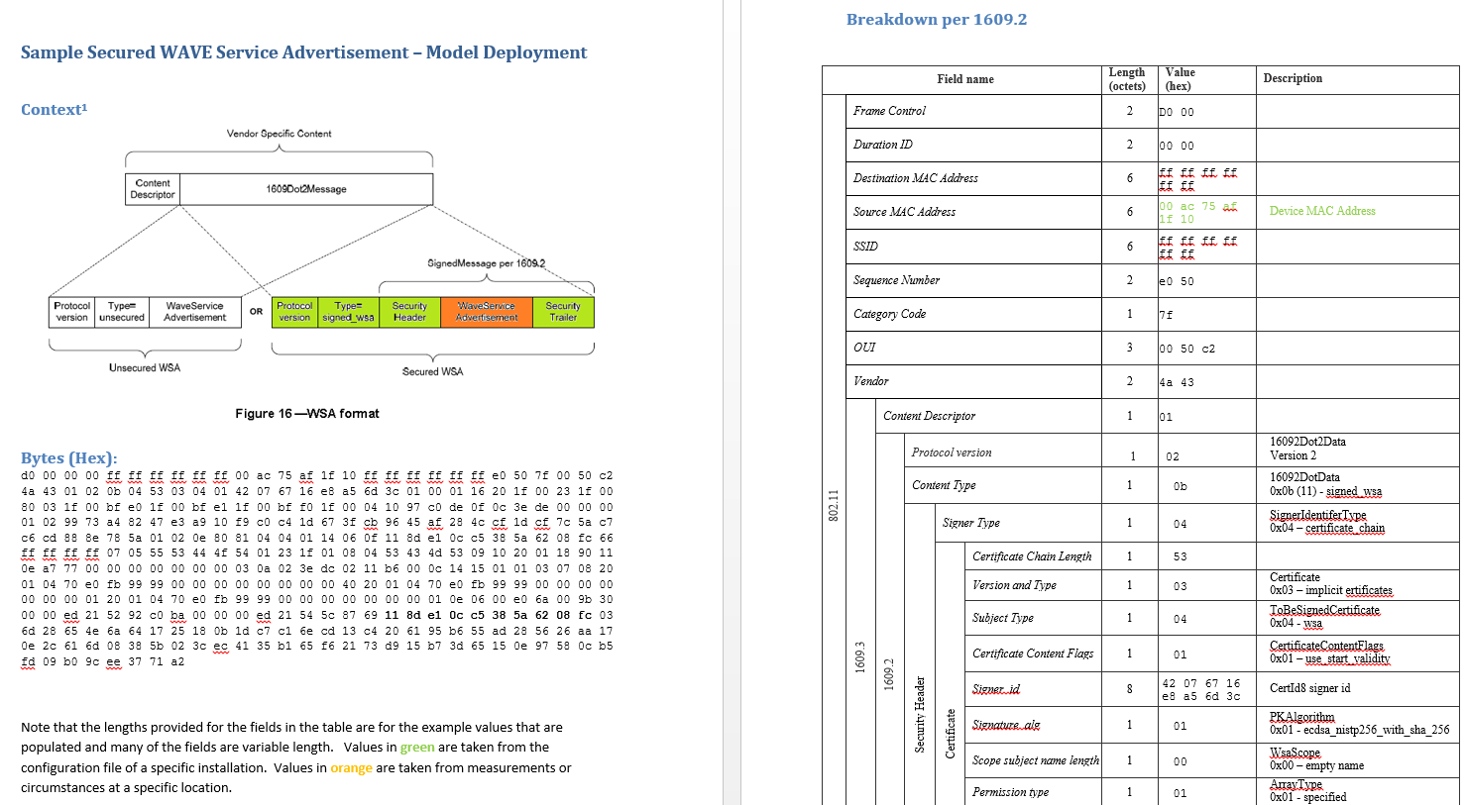
WSA frame example
A sample WSA is included in IEEE 1609.3
  It has many optional fields
  South East Michigan Testbed uses a constrained WSA specified in sample-signedwsa_R3.docx. (to be updated to IEEE 1609.3 version 2016)

Slide 12
OBE in RSE overlapping communication zones
Current specifications assume that any IPv6 transactions must be completed within one RSE communication zone. OBE communication session management between multiple RSEs is not specified.
RSE1
OBE
RSE3
RSE2
In overlapping RSE zones, OBE may start IPv6 communication with RSE1 and still hang-on to RSE1 while traveling through RSE2 and even being completely out of it in RSE3 zone.
OBE
IEEE1609.3 provides mechanism to detect these conditions i.e. knowing distance to RSE, assessing signal strength, etc.
Specific OBE behavior can be defined in device specifications, or managed by other means (i.e. leave to standards and avoid such use during CV Pilots)
Open Topic

Slide 13
Security Profile for Transmitting WSAs
Filed | Value | Notes
Sign Data | True | WSAs are signed
Signed Data In Payload | True | Signed WSA is in the payload of an Ieee16092Data
Set Generation Time In Security Headers | True | Generation time is necessary to prevent replay attacks and ensure the WSA was signed during the certificate’s lifetime. It is not included in the WSA itself so must be included in the security header.
Set Generation Location In Security Headers | True | For a signed WSA, the 2DLocation and 3DLocation optional extension fields in the WSA header should be omitted.
Set Generation Location In Security Header | True | Signed WSAs are retransmitted, so need an expiry time to ensure they are signed regularly
Sign With Fast Verification | Yes | Allows fast verification by appropriately implemented receivers at no cost to the sender
EC Point Format | Compressed | Default value recommended in 1609.2
Repeat Signed SPDUs | True | Saves time on re-signing
Time Between Signing | 30 s | Strike a balance between consuming resources to sign and keeping WSAs fresh
Encrypt Data | False
  For complete security profile for transmitting WSAs refer to SAE IEEE1609.3v3D6 “Annex H”

Slide 14
Security Profile for Receiving WSAs
Filed | Value | Notes
Use Preprocessing | True | Required per 1609.2 since WSAs may have signer identifier type equal to digest. A W SA that is an exact duplicate of a previously received WSA need not be submitted to preprocessing.
Verify Data | Text | Verify a WSA if it contains any PSIDs for which there is an active notification request via a WMEUserService.request. WSAs that are duplicates of already-verified WSAs need not be verified again so long as they are still current based on the 1609.2 Expiry Time and the appropriate WSA header fields.
Generation Time Source | Security headers | Consistent with send side
Expiry Time Source | Security headers | Consistent with send side
Generation Location Source | Security headers | Consistent with send side
Relevance: Certificate Expiry | True | Default value recommended in 1609.2
Encrypted Data | False | WSAs are not encrypted.
  For complete security profile for receiving WSAs refer to SAE IEEE1609.3v3D6 “Annex H”

Slide 15
WSA Security Management Profile
Filed | Value | Notes
Signing Key Algorithm | ecdsaNistP256 withSha1 | Single signing algorithm is desired for interoperability, NIST P256 has better performance than alternatives.
Encryption Algorithm | n/a | No encryption
Implicit or Explicit Certificates | Implicit | Save packet size and processing time
EC Point Format | Compressed | Default value recommended in 1609.2
Supported Geographic Regions | None, Identified, Circular | WSA certificates are recommended to have as small a validity region as possible.
MaximumCertificateChainLength | 6
Use Individual Linkage ID | No | Typical Providers do not have a need for pseudonymity
Use Group Linkage ID | No | Typical Providers do not have a need for pseudonymity
Signature Algorithms | ecdsaNistP256 withSha1 | Single signing algorithm is desired for simplicity of implementations

Slide 16
Field Situation Data Deposits
Regular deposits will be useful for center-based application development
Implementation at the discretion of site operators

Slide 17
Deposit Bundle Definition

Slide 18
Field Data Delivery
Bundles delivered by IP transport
Useful for preparing to encounter controlled intersections

