Slide 1

Standards Rapid Consensus
Day 1, PM – Vehicle Situation Data,
DSRC Basics
Walton Fehr, Transportation Specialist

Slide 2

Welcome
  Presenter –
  Walton Fehr
  USDOT ITS Joint Program Office
  walton.fehr@dot.gov
  www.its.dot.gov
Topics –
DSRC basics
Vehicle Situation Data
  (1) the short-range broadcast data exchanged among vehicles and roadside listeners,
  (2) deposits to the situation data clearing house used for analytics (with privacy protections).

Slide 3
Important Points
All sites will use the same DSRC basics
Vehicle Situation Data Application Protocol Data Units are the same, independent of who creates them and will meet the desired performance requirements.
Using the Situation Data Clearinghouse is encouraged.

Slide 4
Physical View

Slide 5
BSM – Information Flow

Slide 6
DSRC Basics – Broadcast Mode
Broadcast mode covered here.
WAVE Service Advertisements, IP transport covered later.

Slide 7
802.11 Parameters
Radio Parameters
  Channel selection
  Chanel spacing
  Data rates
  Station transmit power classification
  The DSRC Radio Subsystem shall comply with the United States Federal Communications Commission (FCC) specifications
Frame Parameters
  dot11OCBActivated=True
  Data Frame Fields
  User Priority and EDCA Settings
    Three priority classes
    Highest used for urgent safety
    Medium used for other safety
    Low used for all other

Slide 8
Radio Parameters
Message (Rate in Hz)
BSM (10)
IPv6
IPv6
WSA (10)
IPv6
IPv6
IPv6 Exchanges
OBE with SCMS via RSE
OBE with SDC/SDW via RSE
  VSDM
  TSDD
SPAT (10)
TIM (Var)
MAP (1)
RTCM (?)
Power Limit (EIRP)
44.8 dBm
Power Limit (EIRP)
33 dBm
Public
Safety
Veh-Veh Ch 172
Public
Safety/
Private
Ch 174
Public
Safety/
Private
Ch 176
Public
Safety/
Private
Ch 180
Public
Safety/
Private
Ch 182
Public
Safety
Intersections
Ch 184
Control Channel
Ch 178
Frequency (GHz)
5.835
5.840
5.845
5.850
5.855
5.860
5.865
5.870
5.875
5.880
5.885
5.890
5.895
5.900
5.905
5.910
5.915
5.920
5.925
ALL Channels:
  6 Mbps data rate – Per J2945/1
  10MHZ spacing – Per 802.11 Operating Class 17 (J2945/1)
  Station Transmit Power Classification C
    Possible exception Emergency vehicles Classification D
Congestion Control?

Slide 9
802.11 Frame Parameters
dot11OCBActivated=True
  802.11-2012
Data Frame Fields
  J2945/1 for BSM on Channel 172
  COC Performance Specifications for MAP, SPaT, TIM & TSDM
  Specifications will be required for all other applications
User Priority and EDCA Settings
  J2945/1 for BSM on Channel 172
  COC Performance Specifications for MAP, SPaT, TIM & TSDM
  Specifications will be required for all other applications

Slide 10
1609.4 Parameters
Channel usage
  Service and/or Control mandated by profile
Profiles
  V2V (J2945/1)
  SCMS (J2945/1)
  V2I – (By Application)
    COC have generated proposed Profiles for MAP, SPaT, TIM & TIB
    Additional profiles as needed for Pilots

Slide 11
Network Services (IEEE 1609.3)
Current working version: IEEE 1609.3v3 D6. Full publication date is in 2016.
Expected to be used for CV Pilot deployments
In summary
  Standard defines
    WAVE Short Message (used by BSM, SPAT, MAP, TIM, etc)
    WAVE Service Advertisement (used by IPv6 based services, SCMS)
    IPv6 messages (used by SCMS, communications with backoffice applications)
1609.2 security profile for WSA
Support for IP-address randomization

Slide 12
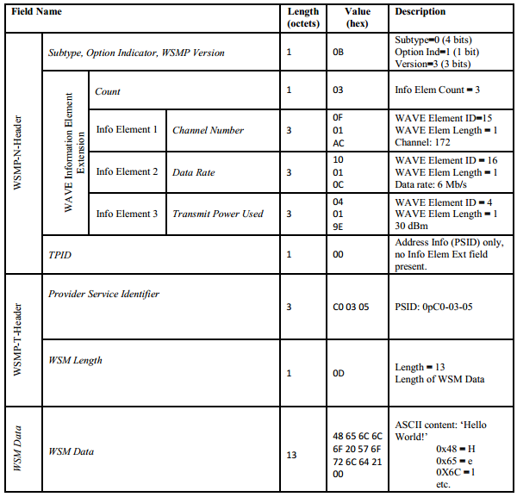
WSM example for Data
Key features:
Version = 3
Subtype = 0
Includes optional elements:
  Channel Number
  Data Rate
  Tx Power User
TPID = 0
WsmMaxLength = 1400
See IEEE 1609.3 Annex G.2 pp 127

Slide 13
Security Services (IEEE 1609.2)
Current working version: IEEE 1609.2v3 D12. Full publication date is in 2016.
Expected to be used for CV Pilot deployments
In summary:
  Standard defines formats and methods to create, decode, sign and verify using:
    Signed messages – used by all broadcast messages (BSM, SPAT, MAP, TIM, etc)
    Encrypted messages – used for IPv6 based communications with backoffice systems
    Security profiles – summary of attributed applicable for a specific type of message
    Mechanism for peer-to-peer certificate distribution
Security Profiles
  Security profile for BSM (covered in SAE J2945/1)
  Security profile for WSA (covered in IEEE 1609.2)
  Security profiles for SPAT, MAP, TIM (COC SyS specifications)
  Security profile for IPv6 messages (TBD)

Slide 14
Security Profile
Message Type | Security Profile | Notes
BSM | Source for PICS 2945.1v5 | Requirement Specifications 1609.2V3D12
WSA | Source for PICS 1609.3v3D6 | Requirement Specifications 1609.2V3D12
SPaT/MAP/TIM | Defined in COC System Functional and Performance Specification Ver. 0.4.0 | Updating security profiles for Spat/MAP/TIM to the latest 1609.2V3D12

Slide 15
Security Profile for Transmitting BSMs
Field | Value | Notes
Sign Data | True | All BSMs are signed
Signed Data In Payload | True | BSM data is encapsulated in the signed data
Set Generation Time ­­In­ Security Headers | True | Prevents replay attacks
Simple­ Signer ­Identifier ­Policy: Minimum Inter ­Cert­ Time | vMaxCertDigestInterval | Attach certificates at a rate of 1/vMaxCertDigestInterval
Simple­ Signer ­Identifier Policy: Exceptions | True | Use full certificate when an event flag in DE_VehicleEventFlags is set.
EC Point Format | Compressed | Reduces packet size. See IEEE 1609.2 [2]
Encrypt Data | False | Encryption is not used for BSMs
  For complete security profile for transmitting BSMs refer to SAE J2945/1V5 Table 10.

Slide 16
Security Profile for Receiving BSMs
Field | Value | Notes
Use Preprocessing | True | Store certificates even for messages that aren’t being verified. Used to verify a digest.
Verify Data | True
Relevance: Generation Time in Past | True | Guards against replay attacks.
Validity Period | 30 seconds | Corresponds to the maximum value of +/-DE_DSecond/2
Acceptable Future Data Period | 30 seconds | Corresponds to +/- the maximum value of DE_DSecond/2
Generation Time Source | Security headers | See IEEE 1609.2 [2]
Consistency: Generation Location | True | Use the position data from the BSM to compare to validity region.
Generation Location Source | Payload | BSM
Overdue CRL Tolerance | 3 years | Setting that corresponds to the number of certificates with which a system is initially equipped.
Relevance: Certificate Expiry | True | Default recommended in IEEE 1609.2
Encrypted Data | False | Encryption is not used for BSMs
  For complete security profile for receiving BSMs refer to SAE J2945/1V5 Table 11.

Slide 17
BSM Security Management Profile
Field | Value | Notes
Signing Key Algorithm | ECDSA-256 | This is the only supported signing algorithm in this standard.
Encryption Algorithm | N/A | Encryption is not used for BSMs
Implicit or Explicit Certificates | Implicit | Reduces packet size. Reduces verification time for verification on demand (see 1609.2 [2]).
EC Point Format | Compressed | Reduces packet size.
Supported ­Geographic ­­Regions | Identified Country only | U.S., Canada, Mexico Note: Any other geographic regions that choose to apply this standard will have to modify this item.
Maximum Certificate ­Chain­ Length | 1
Use Individual Linkage ID | True | Support privacy preserving revocation
Use Group Linkage ID | True | Support privacy preserving revocation
Signature Algorithms in Chain or CRL | ECDSA-256 | This is the only supported signing algorithm in this (2945/1) standard.

Slide 18
BSM Performance Requirements
J2945/1

Slide 19
Time
Time and location would be defined by SAE J2735-2015 (and subsequent updates).
  J2735 defines time using a specific version of UTC and accommodates leap seconds and leap days by allowing minutes to have 61 seconds and months to have anywhere from 28 to 31 days;
  and location using specific units for latitude, longitude, and elevation based on a specific version of WGS-84. Anyone contributing a data unit towards the center of the system (see Architecture) would convert whatever time or location units to those of J2735.
Anyone receiving a data unit toward the edges of the system would expect time and location in units defined in J2735 and be responsible for converting to whatever they need to support their application object.

Slide 20
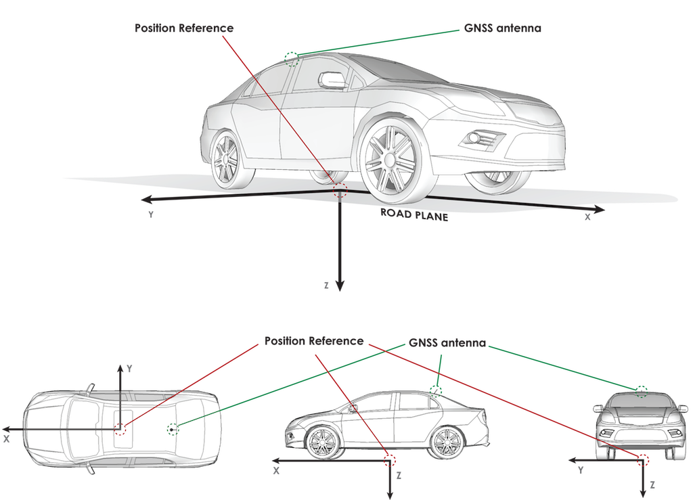
Location Service Performance (J2945/1 D5)
Measured by collecting BSMs in Open Sky Test Conditions (J2945/1 A.7) and compared against recorded data from reference system
At least 68% of test measurements must meet each of the following criteria (independently):
  vPosAccuracy = 1.5 m
  vElevAccuracy = 3 m
  vSpeedAccuracy = 1 kph
  vHeadAccuracyA = 2 deg (greater than 45 kph)
  vHeadAccuracyB = 3 deg (less than or equal to 45 kph)
1.5m
1.5m
1.5m
3m
3m

Slide 21
Other Key Measurements for BSMs
Other Data Accuracy Requirements (J2945/1, 6.3.6)
BSM Transmission Minimum Requirements (J2945/1, 6.3.5)
Transmitted at 10 Hz on Channel 172
Heading latch / unlatch
Hard Braking event
ID Randomization (system startup and cert changes)
  MAC Address
  DE_TemporaryID
Data Persistency: heading and path history (J2945/1, 6.3.7)
BSM Signing (J2945/1, 6.5.2)

Slide 22
Path History
PH checked for each BSM to ensure conformance to Path History Reqs:
  PH Distance between 200 and 210 m
  PH_ActualError <= 1 m
  No more than 15 points
  Time ordered (first point is most recent)

Slide 23
Path Prediction
Each BSM will be checked to ensure it contains DF_PathPrediction and conforms to the requirements in J2945/1 Section 6.3.6.17
Calculated Radius of Curvature is within 2% of the actual radius
Sign is correct (CW vs CCW)
Reports straight path radius when under 1 m/s

Slide 24
Congestion Control, other Requirements
Congestion control defined in J2945/1
  Will this be implemented for pilots?
  If it is, will this be extended for all applications?
Other details of J2945/1

Slide 25
Vehicle Situation Data Deposits
Useful information for analytics
Privacy protection at the source

Slide 26
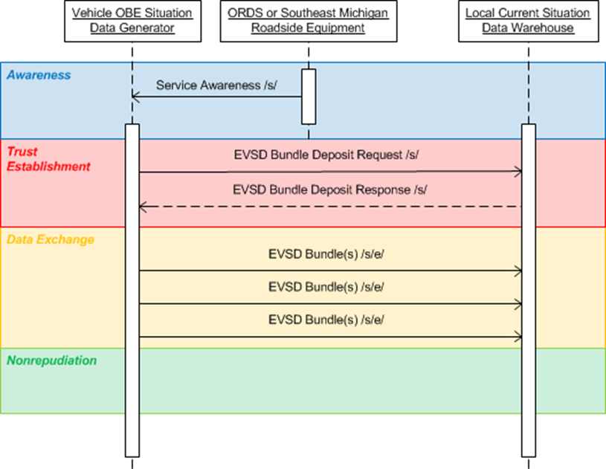
Bundle Definition

Slide 27
Bundle Definition, cont.

Slide 28
Bundle Definition, cont.

