Slide 1
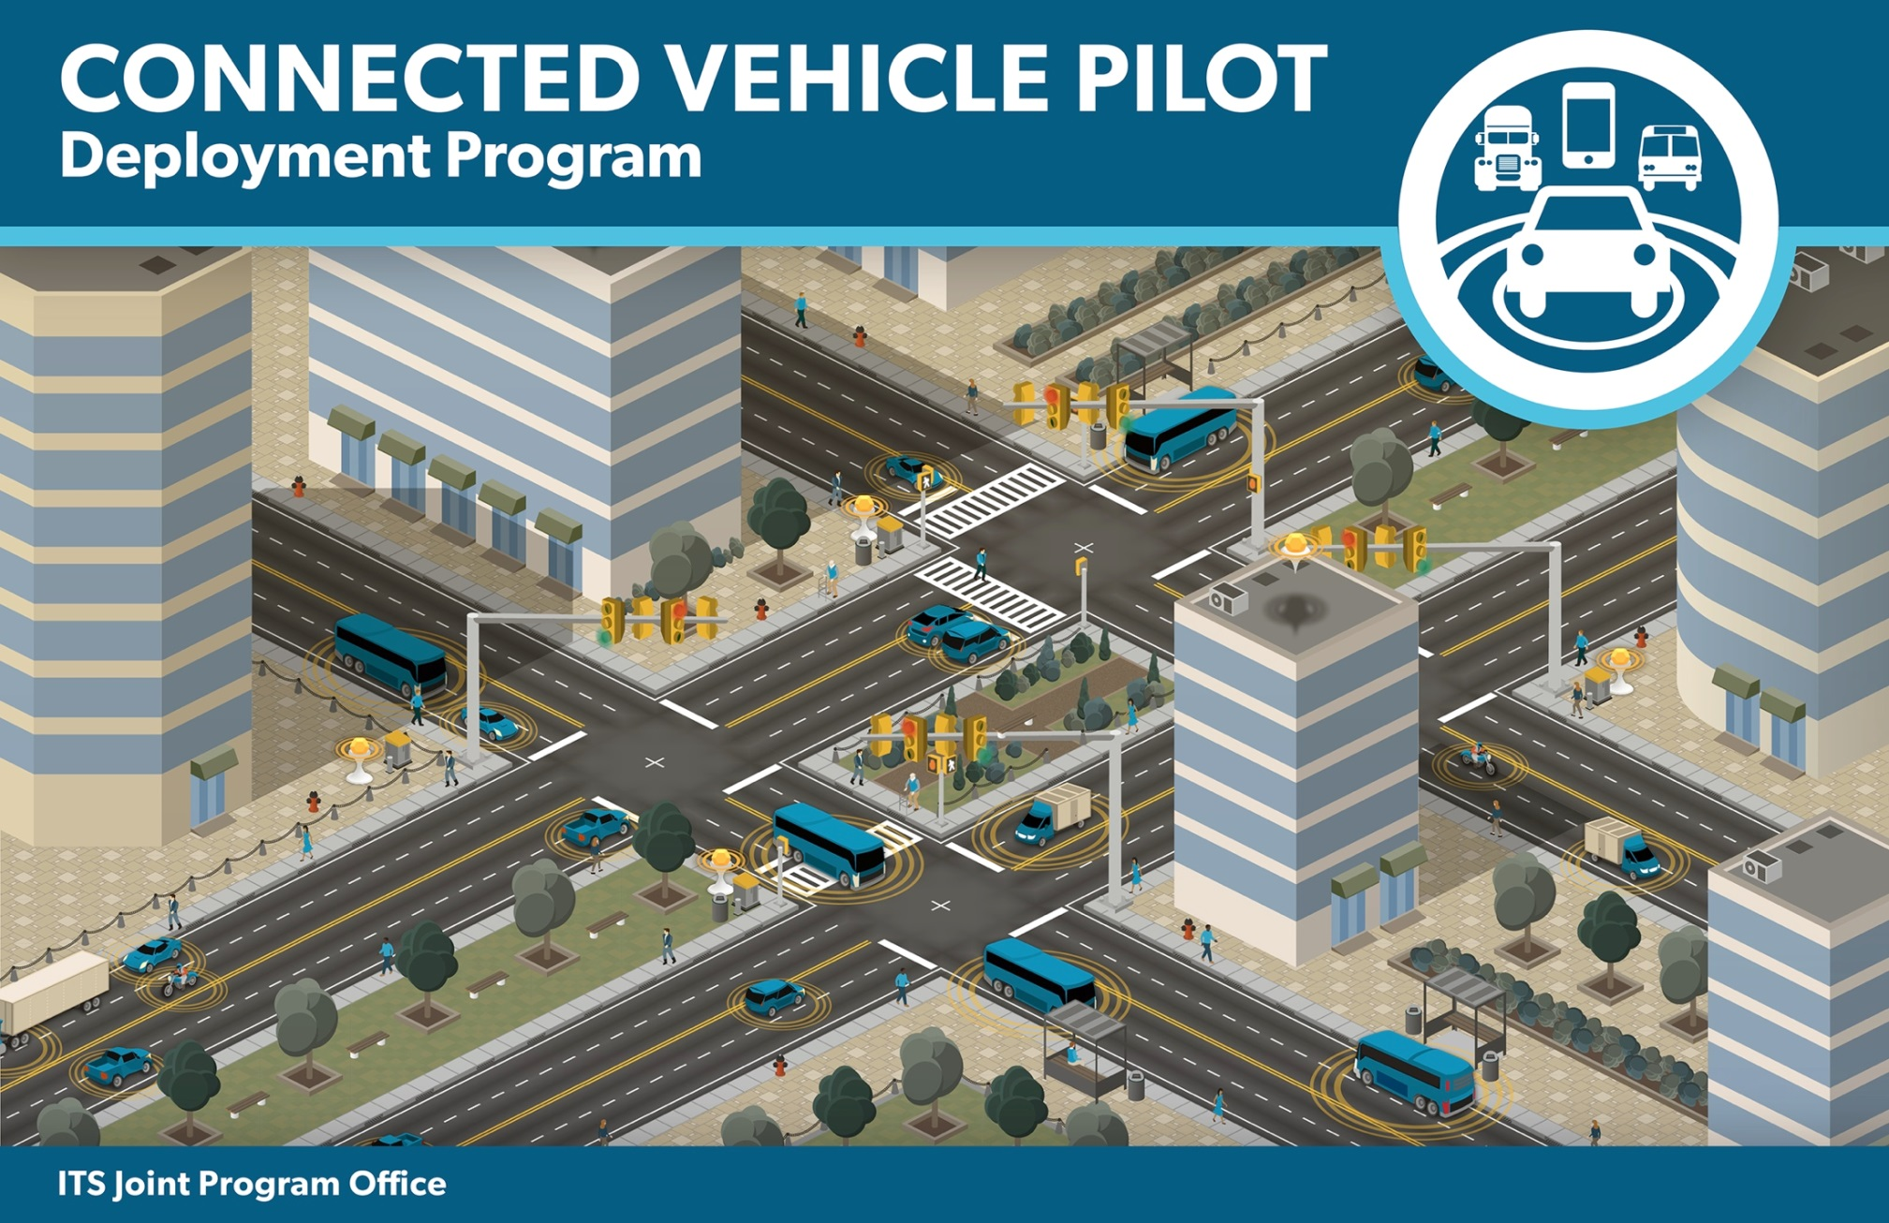
Standards Rapid Consensus
Day 1, AM - Overview
Walton Fehr, Transportation Specialist

Slide 2

Welcome
  Presenter –
  Walton Fehr
  USDOT ITS Joint Program Office
  walton.fehr@dot.gov
  www.its.dot.gov
Topics –
Overview

Slide 3
Definition of Terms
Connected Vehicle Reference Implementation Architecture (CVRIA):
  The Connected Vehicle Reference Implementation Architecture is based on a set of Applications that have been defined by various connected vehicle programs.
  The source for the application descriptions ranges from Concepts of Operations (ConOps), Requirements Specifications, or existing Standards and Architectures.
Unified Implementation of the Reference Architecture
  The result of the dilemma faced by the Test Bed team of how do you actually build a system to accomplish the goals of the CVRIA on a continent-wide scale.
System Engineering Tool – Intelligent Transportation (SET-IT):
  An embodiment of the CVRIA and the Unified Implementation that can serve as a staring point for project architectures

Slide 4
Definition of Terms, Cont.
Application Protocol Data Unit (APDU)
  A defined data structure that is transferred at a peer level between two applications generally installed and operation on different Physical Objects (devices).
Application Protocol Data Unit (ADU) Bundle
  An APDU Bundle is an instantiation of an ADU Bundle Type, which is a formally defined data structure containing of a Bundle Header consisting of one or more Data Elements and a Bundle Body; each consisting of one or more ADU Body data structures (see above).

Slide 5
Agenda for the session
Morning Sections from 10:00 to 12:30 EST, Afternoon Sections from 1:00 to 4:30 EDT
Day 1, AM: Section 1
  Overview and welcome
  Importance of the common understanding of standards and specifications
Day 1, PM: Section 2
  Vehicle Situation Data
  DSRC basics
Day 2, AM: Section 3
  Field Situation Data and Data Clearinghouse deposits
  WAVE IP transport
Day 4, PM: Section 4
  Traveler Situation Data
  SCMS basics
  Wrap up, take always, relationship continuation.

Slide 6


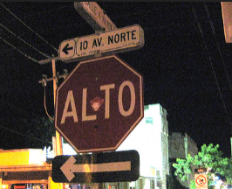
Uniform Implementations
Source: USDOT
The Internet of Something Big
Reference architecture
Consensus definitions
Opportunity for a common experience, ability to do more
Source: Flicker
Notes:
Transportation has passed the “Internet of Things” and has moved on to the Internet of Something Big
We are borrowing heavily on our experience of building important infrastructure on a continent-wide scale
- transcontinental railroad networks, Interstate Highway system, etc.
Uniform deployment based on concepts developed in Southeast Michigan 2014 project.
Fundamental elements of the system will be interoperable.
Reference architecture for consistent implementations
Consensus definitions, interpretation of standards for fundamental data elements
Common communication security practice
Provide for the opportunity for a common experience, the ability to do more.
Goal is continent-wide deployment. Everything in the testing is being developed to be deployed on a much larger scale.
Comments and critiques are welcome

Slide 7

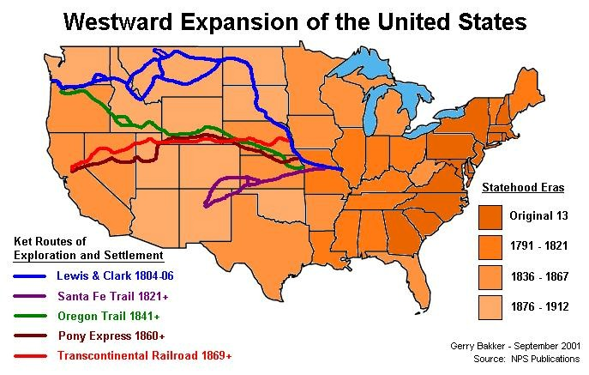
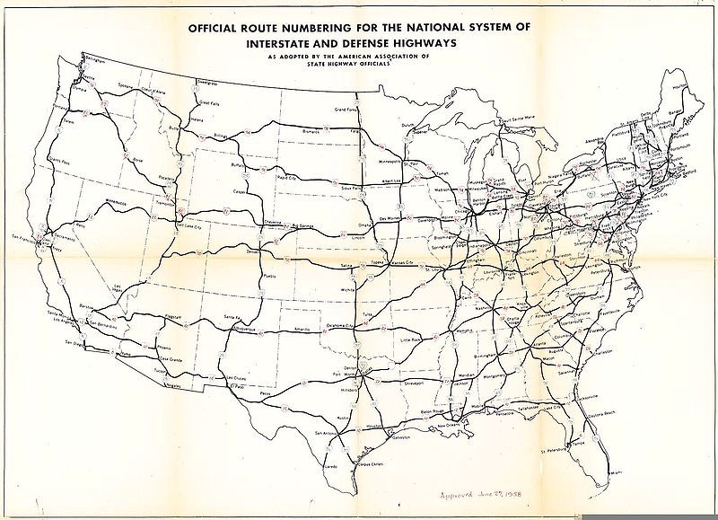
Examples of Something Big

Slide 8
A Variety of Communication Media,
Data Needs
Resources: wired and wireless, the Internet
3,000 miles, 3,000 meters, 300 meters, 3 meters.
Requirements: Two types of data distribution:
To all, To one.

Slide 9
Unified Implementation of the CVRIA

Slide 10
Time and Location References
Time and data elements always travel together
Situation Data
□ The state of a key element of the system at a specific time
□ Defining the data flow and evolution
Time and Location Context to Data and Information

Slide 11
Common Understanding
As data moves toward the center of the system –
It is assumed that every object that is part of, or is utilizing the services of the Unified Implementation of the Reference Architecture, has a common understanding of time, based on Coordinated Universal Time (UTC) as defined by the “International Telecommunications Union Recommendation TF.460-6”, to within 1 millisecond absolute to UTC.
It is also assumed that every object that is part of, or is utilizing the services of the Unified Implementation of the Reference Architecture, has a common understanding of location, using the DE_Longitude, DE_Latitude and DE_Elevation units as specified in the “SAE J2735 - Dedicated Short Range Communications (DSRC) Message Set Dictionary”.
Familiar units are reconstructed at the edges

Slide 12
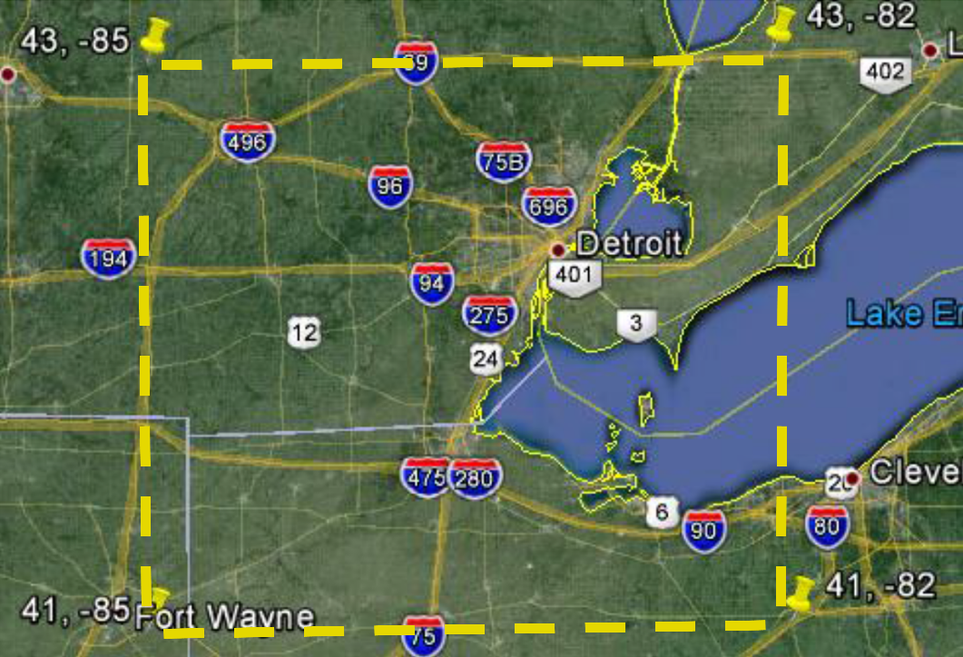
Geographic Reference in data units
As data moves toward the center of the system –
A common understanding of location, using the DE_Longitude, DE_Latitude and DE_Elevation units as specified in the “SAE J2735 - Dedicated Short Range Communications (DSRC) Message Set Dictionary”.
Supports creating tiles of data, the smallest being a 10 millidegree cube.

Slide 13
Privacy/Anonymity Concerns
Formulated to protect the privacy of the users to the highest possible degree possible.
Challenging in a multi-application setting, because
  The user may have higher privacy requirements than a specific application does,
  There is an additional threat to the privacy of the user from correlations between applications.
Some applications by their nature will have to reveal sensitive or user-specific information: for example, BSMs reveal vehicle location.
  This makes it all the more important to ensure that applications do not reveal this information unless it is absolutely necessary, as revealing the information within application A will allow it to be correlated with information from application B.
Further discussion of privacy and security for the multi-application setting can be found in EU-US ITS Task Force Standards Harmonization Working Group Harmonization Task Group 1 report 1-1, “Current Status of Security Standards”, section 14 and Annex C.

Slide 14
Design Features
Broadcast Communications
  Well-known data structures are defined for broadcast communications between objects which do not have a pre-established relationship.
  We use the IEEE 1609.3 WAVE Short Message Protocol (WSMP) to broadcast WAVE Short Messages (WSM) encapsulating these pre-defined data structures.
  These pre-defined data structures will be adopted, adapted or developed based on the structures defined in the SAE J2735 Data Dictionary.
  Examples include SAE J2735 Basic Safety Messages (BSM) broadcast over DSRC and SAE J2735 Signal Phase & Timing (SPaT) Messages broadcast.
Unicast (Transactional) Communications
  Unicast communications are exchanged between two objects for the purpose of enacting a transactional data exchange.
  Any IP based communications path (e.g. 3G, 4G, Wi-Fi, WiMAX) can be used.
  IEEE WAVE over DSRC can be used as the sole hop between the two Unified Implementation of the Reference Architecture objects (for all V2V and some V2I); or it can be used as the first/last hop in a multi-hop routed communications.
  These transactions are usually small data transfers (up to approx. 10 Kbytes).

Slide 15
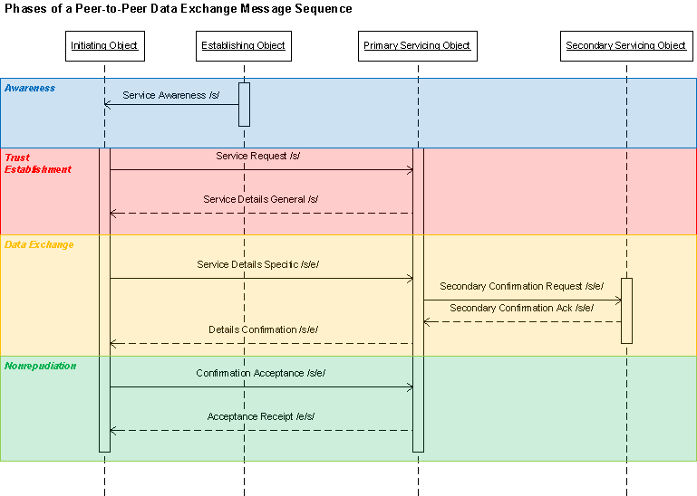
Transactional Unicast Communications

Slide 16
Data Units and Data Bundles
The Unified Implementation of the Reference Architecture has implemented an enhanced Data Distribution Service that supports the brokered exchange between data producers and consumers. As part of this service, two categories of data construct types have been defined:
Application Data Unit (ADU) – An ADU is encoded information exchanged between Application Objects, Generally installed and operation on different Physical Objects (devices).
Application Data Unit (ADU) Bundle –An ADU Bundle is an instantiation of an ADU Bundle Type, which is a formally defined data structure containing of a Bundle Header consisting of one or more Data Elements and a Bundle Body; each consisting of one or more ADU Body data structures (see above).

Slide 17
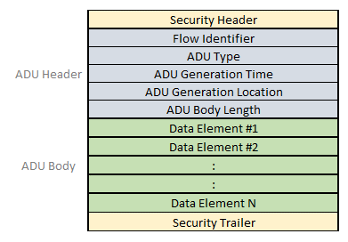
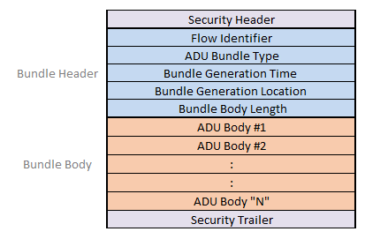
Examples
Principles for data units and data bundles are given in the ConOps

Slide 18
Base Standards
Standards | Title / Scope | Estimated timeline | Use for certification
SAE J2735 | Message definition and data dictionary for BSM, SPAT, MAP, and TIM | Last draft created in Nov 2015 Published std. expected in 2016 | Reference the current draft. Migrate to full published standard when available
SAE J2945/1 | System requirements for V2V Safety Communications (i.e system spec for BSM-based V2V apps) | Last draft V4.0 created in Dec Published std. expected in 2016 | Reference the current draft. Migrate to full published standard when available
SAE J2945/2 | System requirements for infrastructure communications | No draft available | No actions
SAE J3067 / ISO19091 | Candidate Improvements to Dedicated Short Range Communications (DSRC) Message Set Dictionary. System specs for SPAT, MAP, TIM | Published in 2014 | Reference the current standard
IEEE 802.11 | Specifications for MAC/PHY layers | IEEE 802.11 2012 published includes IEEE 802.11p (2010) | Reference the current published standard
IEEE 1609.4 | Specification for WAVE Multichannel Operation | Last draft D5 created in Dec 2015 Published std. expected in 2016 | Reference the current draft. Migrate to full published standard when available
IEEE 1609.3 | Specification for WAVE Networking Services | Last draft D6 created in Nov 2015 Published std. expected in 2016 | Reference the current draft. Migrate to full published standard when available
IEEE 1609.12 | Specification for WAVE Identifier Allocation | Last draft D5 created in Dec 2015 Published std. expected in 2016 | Reference the current draft. Migrate to full published standard when available
IEEE 1609.2 | Specification for WAVE Security Services for Applications and Management Messages | Last draft D12 created in Nov 2015 Published std. expected in 2016 | Reference the current draft. Migrate to full published standard when available

Slide 19
Interface Specifications and Profiles
Information Flow | Title / Scope | Location | Current status
Vehicle Situation Data Deposits | Protocols and message format for VSDM data deposits into Data Center | CPS-VO / SEMI / EVSD / LC Enhanced Vehicle Situation Data Deposit V2.2 R9 | Maintained by South East Michigan Testbed team
Traveler Situation Data Distribution | Protocols and message format for TSDM data distribution to roadside equipment | CPS-VO / SEMI / TSD / LC Traveler Situation Data Distribution V2.2 R13 | Maintained by South East Michigan Testbed team
Sample SPAT | Sample profile for SPAT message | SAE SPaT_2015_R0 | Maintained by South East Michigan Testbed team
Sample MAP | Sample profile for MAP message | SAE Map_2015_R1 | Maintained by South East Michigan Testbed team
Sample WSA | Sample profile for WSA message | sample-signedwsa_R3 | Maintained by South East Michigan Testbed team
Sample TIM | Sample profile for TIM / Curve Speed Warning message | CSW Template_R4, TIM-Based Curve Speed Warning Application Message Details_R8 | Maintained by South East Michigan Testbed team

Slide 20
Certification Operating Council Specifications
Information Flow | Title / Scope | Location | Current status
MAP Broadcast System Specification | Protocol, message and system requirements supporting broadcast of MAP messages | Unpublished | Draft document is prepared
Signal Phase and Timing Information Broadcast System Specification | Protocol, message and system requirements supporting broadcast of SPAT messages | Unpublished | Draft document is prepared
Traveler Information Broadcast System Specification | Protocol, message and system requirements supporting broadcast of Traveler Information Messages | Unpublished | Draft document is prepared
Local Traveler Information Distribution Data System Specification | Protocol, message and system requirements supporting Traveler Situation Data Messages (TSDM) | Unpublished | Draft document is prepared
WAVE802.11-TSS&TP | Test Suite Structure and Test Purposes for 802.11 | Unpublished | Draft document is prepared
WAVEMCO-TSS&TP | Test Suite Structure and Test Purposes for Multi Channel Operation | Unpublished | Draft document is prepared
WAVENS-TSS&TP | Test Suite Structure and Test Purposes for Network Services | Unpublished | Draft document is prepared
WAVESEC-TSS&TP | Test Suite Structure and Test Purposes for Security Services | Unpublished | Draft document is prepared
J2945.1-TSS&TP | Test Suite Structure and Test Purposes for J2945.1 | Unpublished | Draft document is prepared
SPAT-TSS&TP MAP-TSS&TP | Test Suite Structure and Test Purposes for SPAT/MAP | Unpublished | Draft document is prepared
TIM-TSS&TP | Test Suite Structure and Test Purposes for TIM | Unpublished | Draft document is prepared

Slide 21
Other Specifications
Information Flow | Title / Scope | Location | Current status
SCMS interface | Protocol and interface messages to request security credentials, security revocation lists and upload misbehavior reports | Unpublished | Created by the team implementing the new SCMS. Work in progress

Slide 22
Goals For Certification
Conduct Device Certification to ensure:
  Conformance to the message protocols
    Ability to transmit & receive messages using specific protocols
    Use message security and security credentials
  Conformance to performance requirements
    Use position and timing information
    Radio behavior characterization
  Device interoperability regarding selected information flows
Notes:
? Minimum performance …

Slide 23

How CV Pilots can use Certification Services
A Site Operator requests the Certification Operating Council (COC) to develop certification testing based on the Device Requirements
COC develops Test Specifications based on Device Requirements
  COC and the Site Operator agree on certification criteria
The Site Operator references Test Specification in the procurement guidelines to Vendors
Vendors submit products to COC for the Certification Testing
COC conducts device testing per Test Specification
COC uses 3rd part test results + results from their own certification testing
COC issues certification verdict
COC issues Certification Mark on passing
Site Operator buys marked devices
Notes:
If it passes – we give certification sticker…

Slide 24
Pre-requisites for Device Certification
Requirements
Passing
criteria
Device met passing criteria?
Test specs
Test methods
Test tools
Testing
Yes
Certificate of
compliance
awarded
No
Having defined minimum requirements (i.e. scope of testing, device profiles) and passing criteria (PICS) is required to create test specifications, test methods and test tools.

Slide 25
What to expect from a certification service:
In scope
  Suitability for environment
  Interface testing
    Radio behavior testing
    Wired and wireless protocol testing
    Message protocol conformance for
      DSRC-based: BSM, SPAT, MAP, TIM
      Vehicle Situation Data Message
      Traveler Situation Data Message
Not in scope
  System integration testing
  Field testing
  Application testing
  Installed performance testing
    Performance may vary depending on device specific installation, site selection, length of antenna cable, and etc.
Under consideration
  Device testing according to specific define profile
Notes:
VSDD, TSDD change to spell out, change to messages.
Over-the-air radio testing -> clarify… radio capable if installed correctly.
Add RSU 4.0 into title. RSU 4.0 Certification testing..
Remove – software regression testing,

Slide 26
Scope of Development in Current Work
4 - Overall Application Abilities
Applications
3 - Interface Abilities
1 - Environmental Abilities
2 - Communication Protocol Abilities
Basic Device
Certification Levels -
Environmental Abilities including Physical Security,
Communication Protocol Abilities,
Interface Abilities (both the syntax and contents of the message payload transmitted over the communications medium), and
Overall Application Abilities.
COC efforts focused on testing 2 and 3

Slide 27
Common Certification Modules Coverage of RSU 4.0
19% Supported by existing test methods provided by various labs
  FCC
  Environmental
  Physical
31% Supported by COC certification modules under development – cover testing sufficient to validate interoperability
  IEEE 1609
  IEEE 802.11p
  Radio behavior testing
  DSRC message structure
50% Not supported by COC modules under development - doesn’t affect over-the-air interoperability; implementations may vary between different RSU providers
  Logging / Configuration
  MIB
  Operating System
Note: Current RSU 4.0 spec. uses obsolete standards. The new standards (SAE J2735, J2945/1, IEEE 1609) are expected in early 2016. RSU Spec must be revised and updated accordingly.
Notes:
Risk: SAE J2945, IEEE 1609.2, .3, .4 are not complete and are being updated.
* Prioratized for selected applications and most important interoperability aspects
Message structured properly and valid content??
?? Highlight the NOTE.

Slide 28
Steps Toward RSU 4.X Testing
Update requirements document (in progress)
  Revise RSU specification toward new revisions of SAE/IEEE standards,
  Revise RSU to support specified applications (i.e. selected for CV Pilots)
Agree on the scope of testing (in discussion during this meeting)
  Identify individual requirements that will be tested by an independent party
  Identify individual requirements that will be self-certified
Prepare for Testing (on-going work)
  Prepare Master Test Plan (as per IEEE 829 Std.)
  Prepare test specifications tailored to the RSU requirements
  Determine certification guidelines and passing criteria

Slide 29
Questions to be addressed for CV Pilots
What applications to be supported at each site (NY City, Tampa and Wyoming)
What classes of devices to be used (vehicle, aftermarket, carry-on, roadside)
What standards versions CV Pilots plan to use
  IEEE 1609.3, 1609.4, 1609.2, J2735 (BSM, TIM, SPAT/MAP) are changing
  What security implementation and certificate management implementation (SCMS) will be supported
  Interface definition between RSU and traffic controllers, and other devices
  How DSRC-based messages will be collected/archived
  How RSU devices will be managed remotely
What are criteria will be used for selecting devices/systems for the CV Pilots

